Slide 1
Data Types
In JavaScript

Slide 2
Primitive Data Types in JavaScript
Number – the number data type covers both integers and floats
Boolean – true or false
String – grouping of characters
Undefined – the value of the variable has not been assigned yet
Null – the variable has been assigned a null value (the no value object)

Slide 3
The Number type
JavaScript does not have different types dedicated for whole numbers, floating point numbers, etc. There is only the general Number type which covers all
let age = 30;
let ageNextYear = age + 1;
let radius = 4.8;
let circumference = Math.PI * radius;
Number has some very useful properties, like:
Number.MAX_VALUE; // The largest positive representable number
Number.MIN_VALUE; // The smallest positive representable number

Slide 4
Integer vs Floating point number
An integer is a whole number, while a floating point number is a real number
let integer = 30;
let floatingPoint = 1.25;
Floating-point arithmetic does not behave as we would expect
let floatingPoint = (0.3).toFixed(20);
// 0.29999999999999998890
This is due to the conversion which happens under the hood in the computer.
It represents every digit with the power of 2
Is floating point math broken

Slide 5
The Boolean type
Boolean variables can only be true or false. They are either used directly or through expressions that evaluate to them
let a = true;
let b = false;
Use this data type for true/false conditions
By convention, boolean variable names are usually question-like
“areEqual”, “isChecked”, “shouldContinue”, “isValid”
let isValid = true;
let hasError = !isValid;
console.log(isValid); // true
console.log(hasError); // false

Slide 6
The String type
Strings represent grouping of characters.
A string value can be an empty string, a single character or more than one characters.
Strings can be declared with single (') or double (") quotes, as well as backtick sign (`).
let name = "Peter";
let address = 'Al Malinov 31';
console.log(name); // Peter
Prefer using the single quote over the double ones!

Slide 7
The String type
We can use backticks when we need to embed a value in a string
let name = 'Peter';
let greeting = 'Hello ' + name; // still works but hard to use
let greeting2 = `Hello ${name}`; // backticks allow for easy interpolation
console.log(greeting); // Hello Peter
There are some very useful functionalities on the String type:
console.log(name.length); // 5
console.log(name.toUpperCase()); // 'PETER'
console.log(name.repeat(3)); // 'PeterPeterPeter'

Slide 8
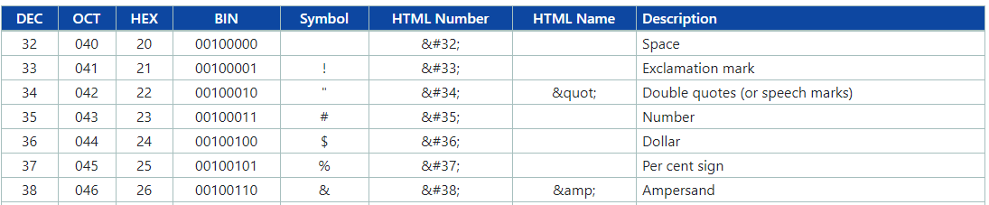
Characters
Every character in a given string is represented in the computer with a code
You could access every character by either a code or a symbol ASCII character. ASCII code is the numerical representation of a character such as 'a' or '@‘

Slide 9
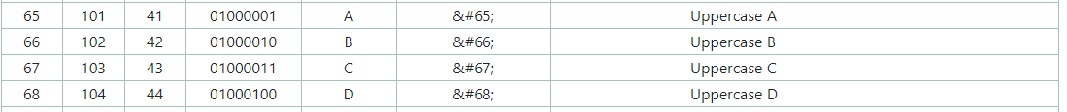

Characters
From symbol to number
let a = str.charCodeAt(0); // 81
let str = 'Q&A';
let b = str.charCodeAt(1); // 38
let c = str.charCodeAt(2); // 65

Slide 10
Characters
From number to symbol
let code1 = 81;
let code2 = 38;
let code3 = 65;
let char1 = String.fromCharCode(code1); // Q
let char2 = String.fromCharCode(code2); // &
let char3 = String.fromCharCode(code3); // A

Slide 11
The undefined type
Variables that are declared but not initialize are set to undefined.
We can also explicitly initialize a variable as undefined as well.
let a; // declared, non-initialized = undefined
let b = undefined; // declared and initialized = undefined
let c = (a === b); // true

Slide 12
The undefined and null types
null is the value which indicates the absence of any value
It’s different from undefined in several ways:
Non-initialized variables default to undefined, not null.
We must explicitly initialize variable with null (or set to null later) for it to be null
console.log(undefined === null); // false
When you want to set a variable to an empty value, always prefer null over undefined.

Slide 13
Parsing
Parsing is the process of converting a value from one type into another
let countString = '5';
let count = Number(countString); // 5
let count1 = +countString; // 5 the same as Number()
Prefer using Number instead of just "+" when parsing
Because of the dynamic nature of JavaScript, non-valid values will be parsed as well without any errors or warnings
let not_a_number = Number('25apple'); // NaN
let nullString = String(null); // 'null'
let trueFromString = Boolean('Marry'); // true
let falseFromEmpty = Boolean(''); // false

Slide 14
Type Safety with Number operations
JavaScript allows us to use mathematical operations on all data types, not only numbers.
If the variables can not be converted to numbers, a special NaN value will be produced.
NaN stands for "not a number", but its type is "number".
let noValidResult = 4 / 'apple';
console.log(noValidResult); // NaN
The only way to check if a value is NaN is to use isNaN:
console.log(isNaN(NaN)); // true

